Slide 1
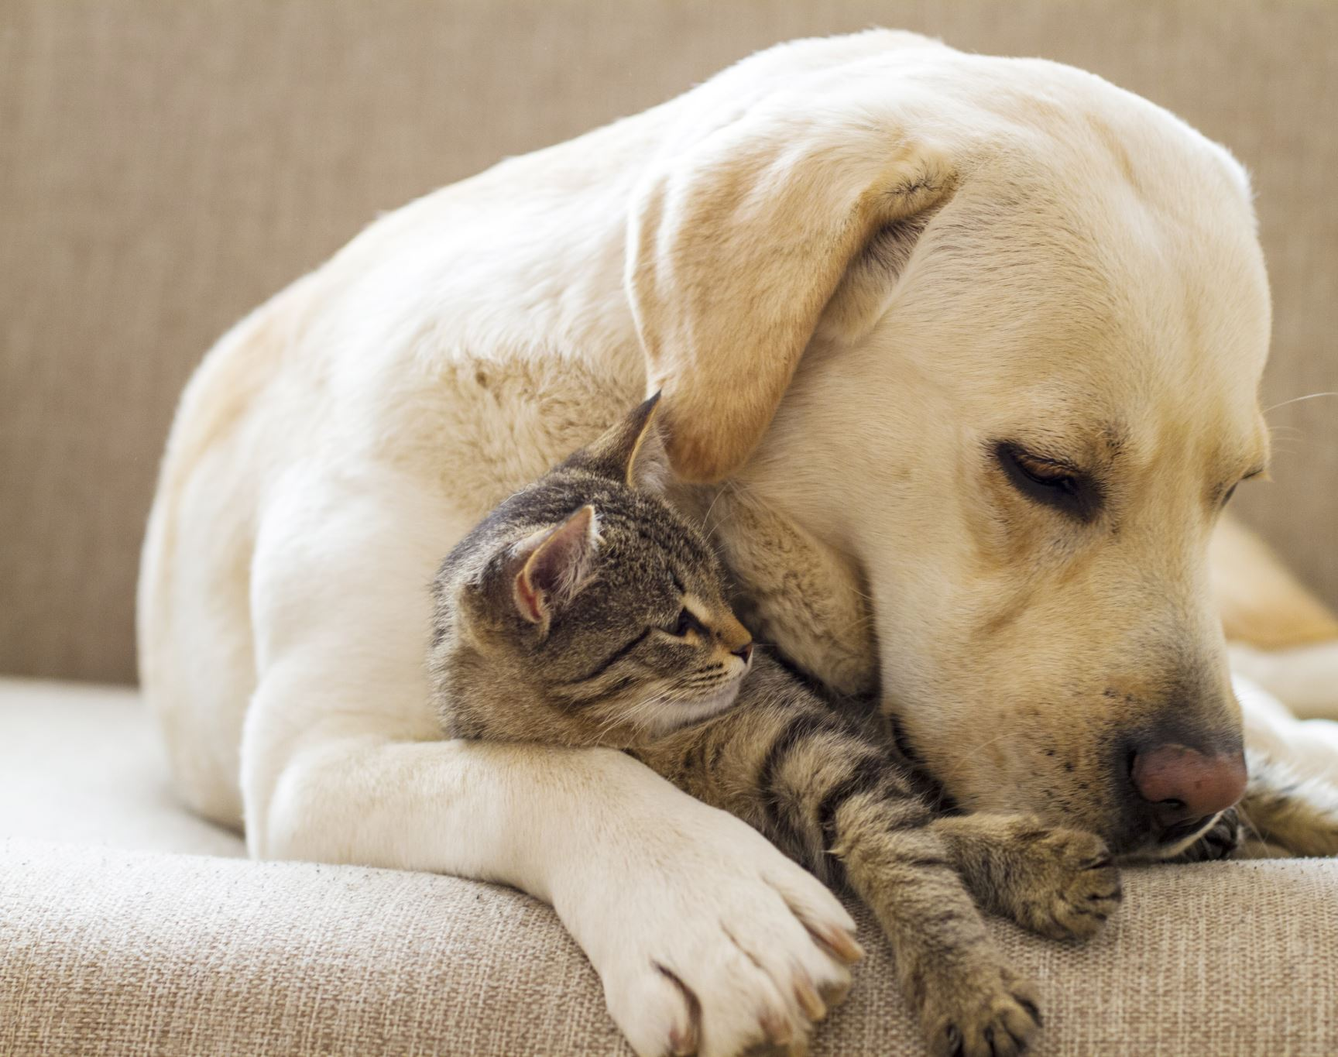
My home Buddy (cat and dog classification)
Dhruthi Sridhar Murthy - 904019545

Slide 2
What is CNN algorithm?
A CNN algorithm is a type of deep learning algorithm that is particularly well-suited for image recognition and processing tasks.
The CNN is a type of Deep learning neural network architecture commonly used in computer vision.
Computer vision is a field of artificial intelligence that enables a computer to understand the image or visual data.

Slide 3
Explanation of CNN algorithm
The main idea behind convolutional neural networks is to extract meaningful features from the input data, which can be used for classification, segmentation, and object detection tasks.
CNN consists of several layers like convolutional, pooling, and fully connected layers.
The convolutional layers extract low-level features, such as edges and textures, while the fully connected layers are used for high-level reasoning, such as object recognition.

Slide 4
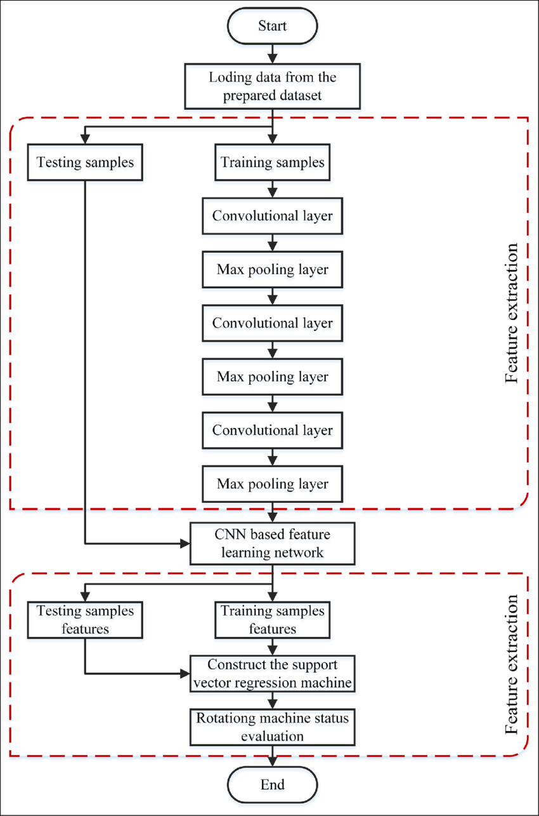
Analysis of a CNN algorithm

Slide 5
Implementation of CNN on my Model
The CNN algorithm classifies the dog and the cat images using the dataset organized as train and test datasets.
Then, the layer is trained with the CNN algorithm to classify the data.
The CNN algorithm discriminates which image belongs where and then the data is classified.

Slide 6
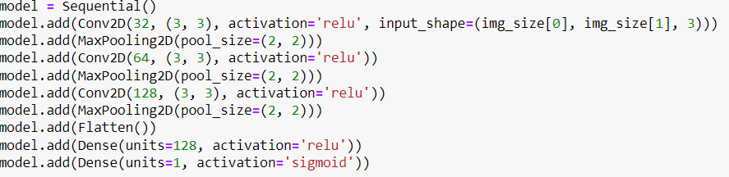
Snippet of a CNN algorithm implementation

Slide 7
Dataset Introduction
CIFAR 10 dataset – this dataset consists of 60000 32x32 color images. The images are labeled with one of 10 mutually exclusive classes.
MNIST - dataset consists of 60000 small square 28x28 pixel grayscale images of handwritten single digits between 0 and 9.

Slide 8
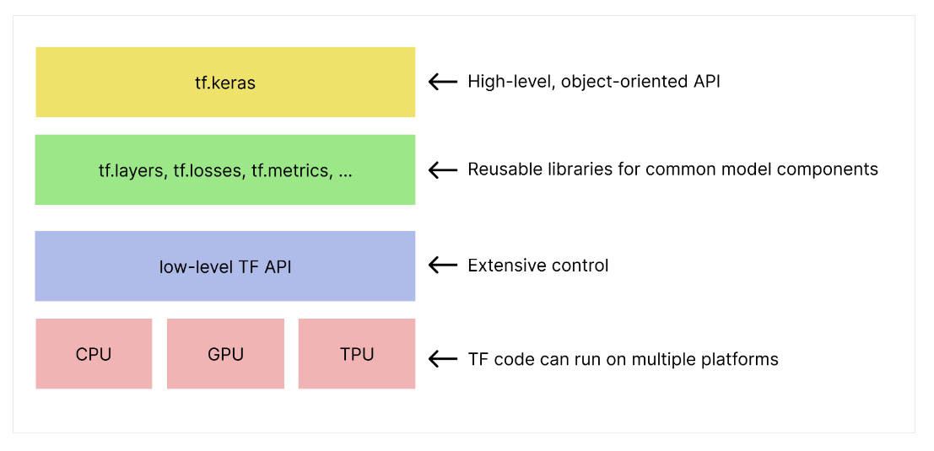
Tensorflow and keras
TensorFlow is an end-to-end open-source platform for machine learning. TensorFlow is a rich system for managing all aspects of the machine learning system.
The TensorFlow APIs are arranged hierarchically, with the high-level APIs built on the low-level APIs, as shown in the figure.
Keras is a highly productive interface for solving machine learning problems, with a focus on deep learning.

Slide 9
Epoch in Machine learning
An epoch is when all the training data is used at once and is defined as the total number of iterations of all the training data in the cycle for training the machine learning model.
An epoch comprises one or more batches, where we use a part of the dataset to train a neural network.
In our model training, the epoch is set to 10 so that the model will be trained and test 10 times.

Slide 10
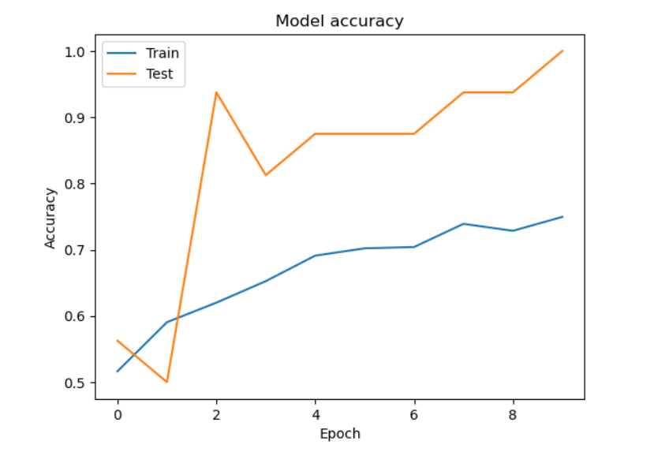
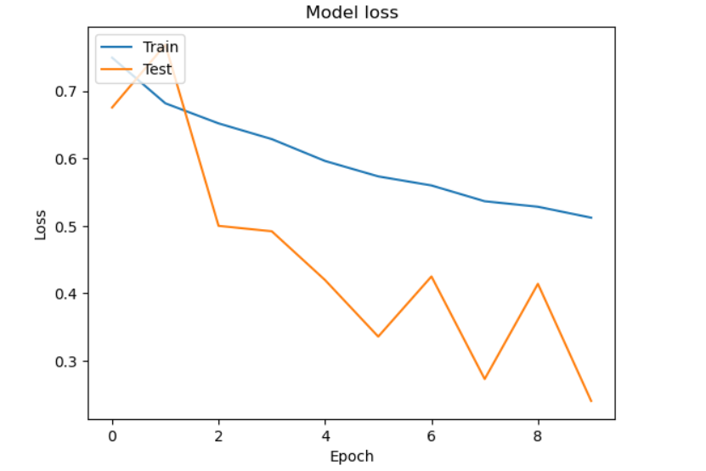
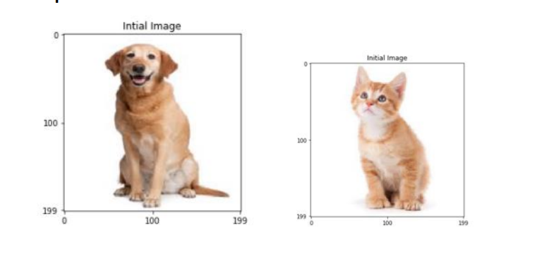
Experimental Results
This images are classified into cat and dog based on the dataset
Test accuracy is generated of about 89%. The model miss read few of the data.
The accuracy is tested based on the epochs value. A graph is generated for epochs and the accuracy.

